Slide 1

Postal Code Presentation Demo
Laxminarsimha Maringanti

Slide 2
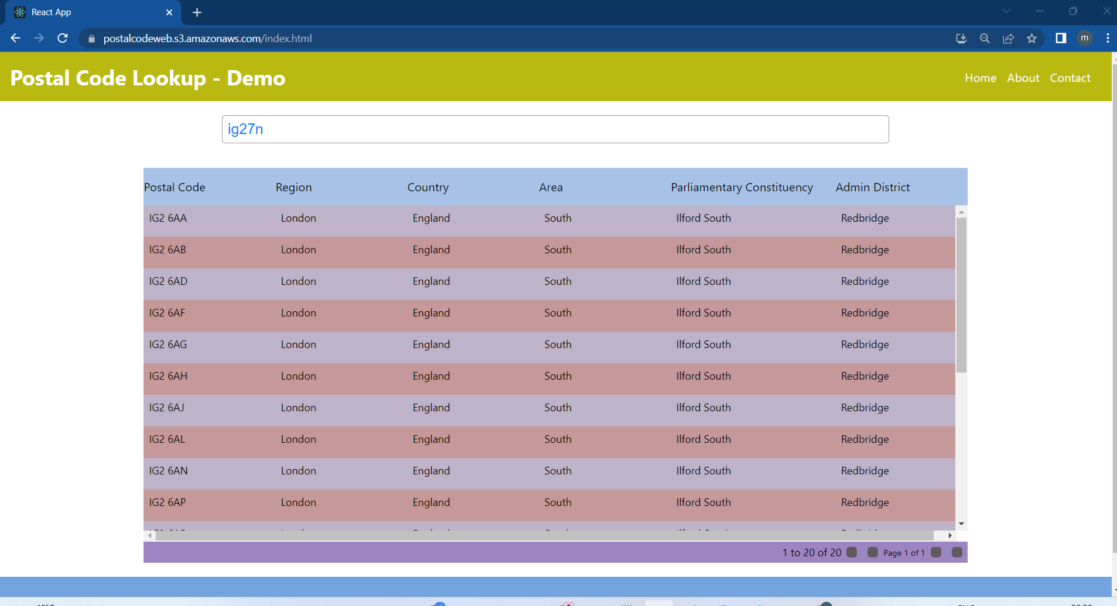

Slide 3
https://postalcodeweb.s3.amazonaws.com/index.html
https://g8w4x6soxi.execute-api.us-east-1.amazonaws.com/Prod/swagger/index.html
https://github.com/maringanti1/PostalCodeLookupWeb.git
https://github.com/maringanti1/PostalCodeLookupAPI.git

Slide 4
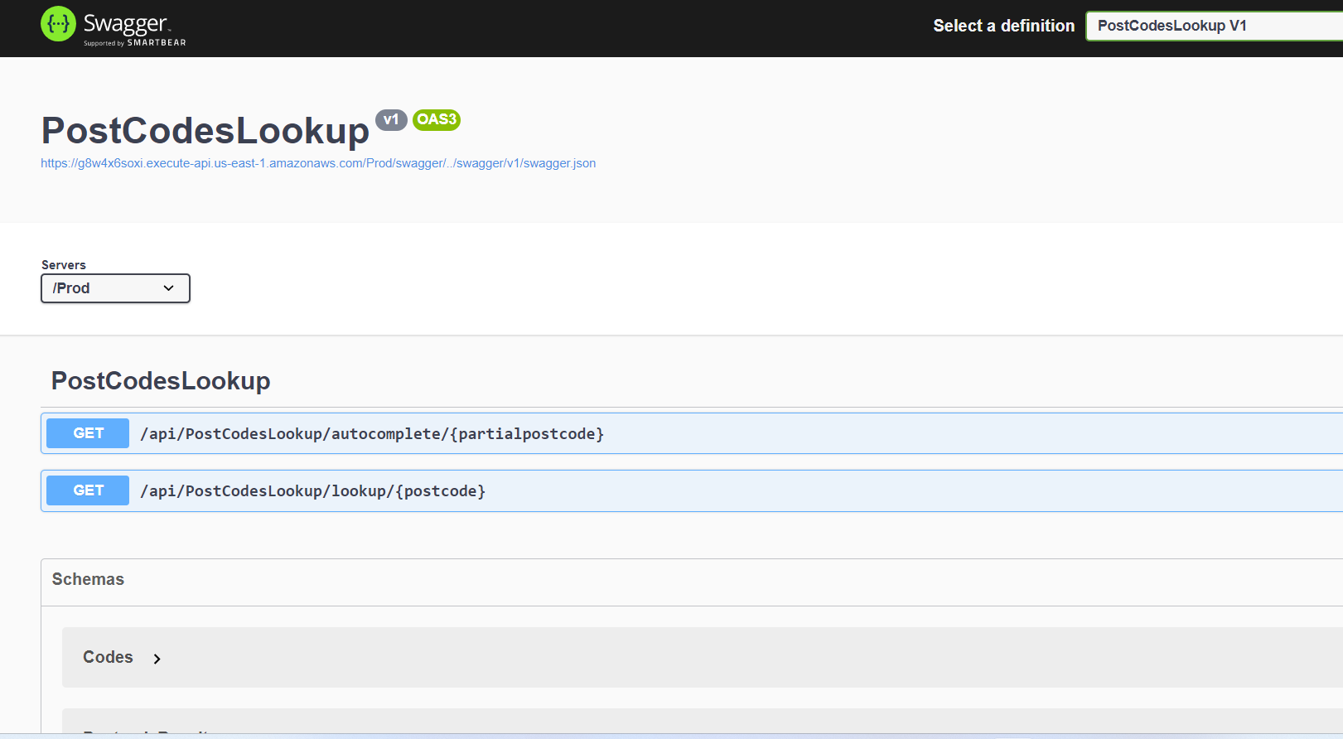

Slide 5
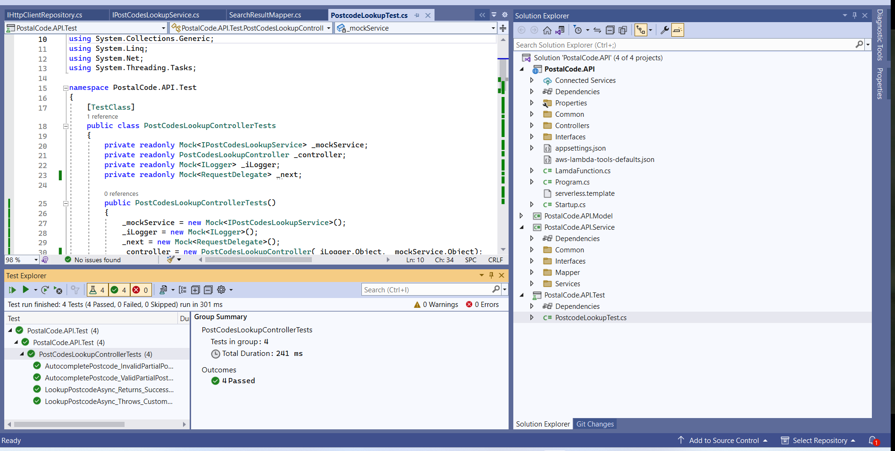

Slide 6
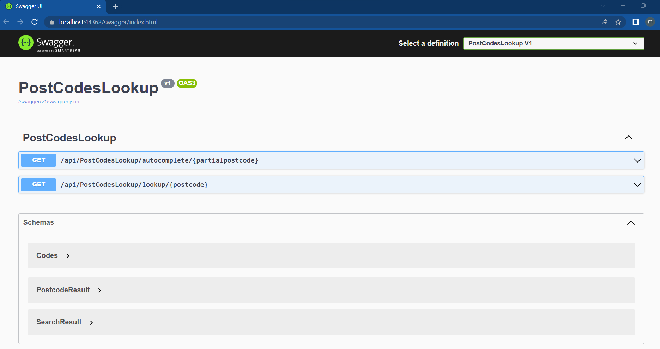

Slide 7
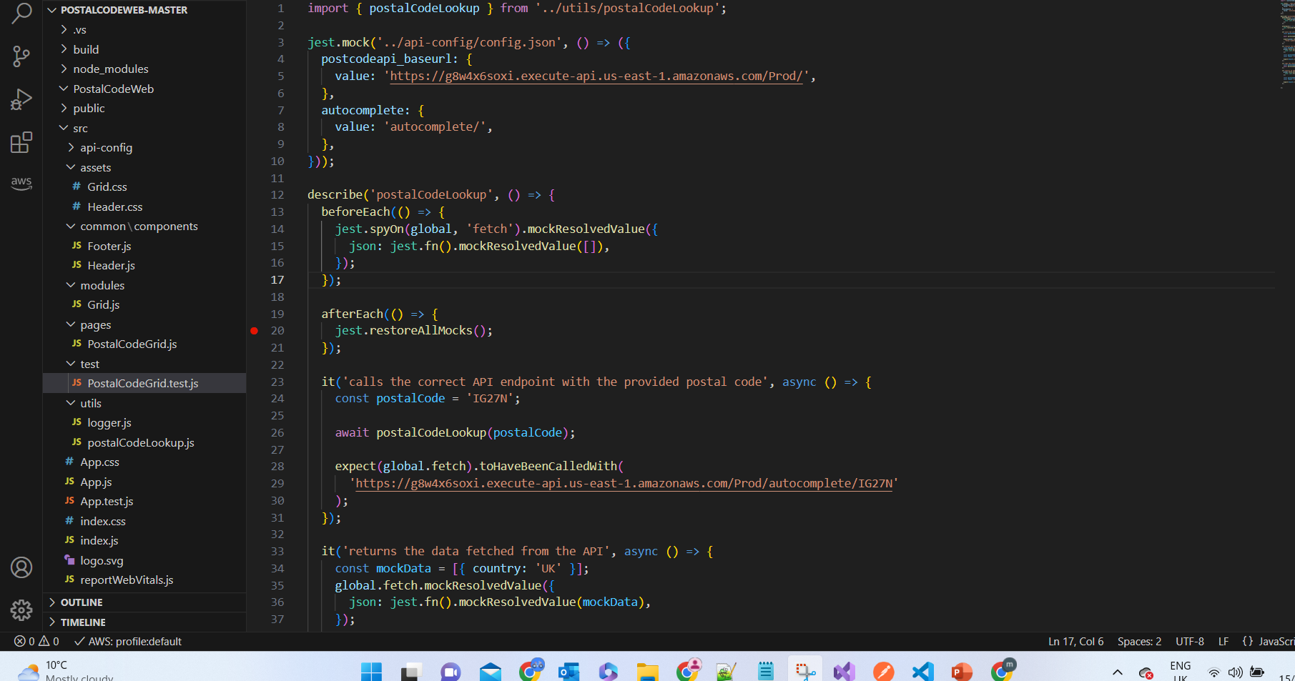

Slide 8
